Slide 1

Implementing Advantage Actor-Critic (A2C) Algorithm using a Stochastic Policy
Presented by: Akhil Kumar, Karthik Natarajan, Tushar Srivastava, Nisarg Vyas

Slide 2

Abstract
A2C Agent
We implemented an Advantage Actor-Critic (A2C) reinforcement learning agent. It handles continuous control tasks.
Stochastic Policy
A stochastic Gaussian policy was used. It features a feedforward neural network architecture.
Environment
The model was applied in OpenAI Gym's Pendulum-v1 and Cartpole-v1 environments.
Optimization
Policy optimization used advantage-based gradient updates. This improved stability and learning efficiency.

Slide 3
Problem Statement & Objectives
1
RL Agent Design
Design a reinforcement learning agent. It must be based on the A2C algorithm.
2
Stochastic Policy Implementation
Implement a stochastic policy. It should use a feedforward neural network for continuous action spaces.
3
Environment Application
Use Pendulum-v1 and Cartpole-v1 as testbeds. This helps learn torque-based control.
4
Action Optimization
Optimize agent actions. This involves policy gradients (actor) and value estimation (critic).
5
Performance Evaluation
Evaluate learning performance. Use cumulative rewards and simulated video output.

Slide 4
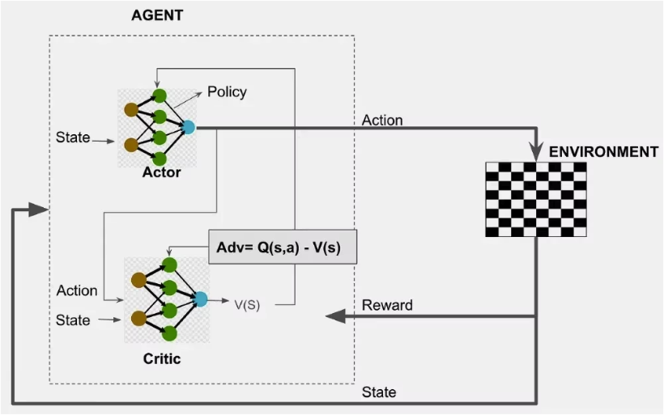
A2C Architecture
The A2C architecture integrates an actor and a critic for efficient policy optimization.
Actor: Selects actions based on learned policy.
Critic: Evaluates actions using value function estimates.
TD Error: Difference between predicted and actual returns.
Policy Gradient: Optimizes policy using expected return gradients.

Slide 5



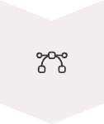

A2C Algorithm
Initialize Networks
Actor and critic networks are initialized. They share parameters.
Sample Trajectories
The agent interacts with the environment. It collects states, actions, and rewards.
Compute Advantage
Calculate the Generalized Advantage Estimate (GAE). This uses TD errors.
Update Networks
Actor and critic losses are combined. They update parameters via gradient descent.
Repeat
The process iterates until convergence. This refines policy and value functions.

Slide 6

Approach to Solve the Problem
1
Training Loop
Run for a defined number of episodes. Sample actions from the policy.
Step through the environment. Compute TD target and advantage.
Backpropagate the combined actor-critic loss.
Log total reward per episode for evaluation.
2
Evaluation
After training, evaluate the policy. Generate a simulation video.
Sample actions using the learned policy. Save rendered frames.
Create a visual output of agent performance.

Slide 7

HYPER PARAMETER TUNNING
Gamma (Discount Factor): Controls the importance of future rewards. A higher gamma means the agent considers long-term rewards more heavily, while a lower gamma focuses on immediate rewards. Typical values range from 0.9 to 0.99.
Learning Rate: Determines the step size at each iteration while moving towards a minimum of the loss function. A small learning rate can lead to slow convergence, while a large one might overshoot the minimum and fail to converge. Separate learning rates may be used for actor and critic.
Network Size: Refers to the number of layers and neurons in the actor and critic neural networks. Larger networks can learn more complex policies but are prone to overfitting and require more computational resources. Smaller networks might underfit.
Batch Size: The number of samples (trajectories or experiences) used in one gradient update step. A larger batch size provides a more accurate estimate of the gradient but requires more memory and computational time. Smaller batch sizes can introduce more noise but might lead to faster convergence in some cases.

Slide 8
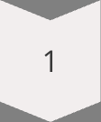
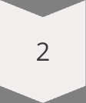
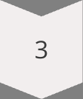
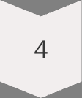
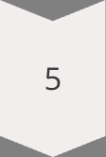
Iterative Optimization Journey: A2C Hyperparameter Tuning
Our approach to fine-tuning the A2C algorithm involved a systematic iterative process, exploring various hyperparameter configurations over extensive training episodes to achieve optimal performance.
Extensive Episode Training
Iterated through 800-1000 episodes to ensure robust model convergence and performance stability across diverse scenarios.
Consistent Random Seed
Utilized a fixed seed of 777 for all experiments to ensure reproducibility and allow for direct comparison of different configurations.
Adaptive Learning Rate Exploration
Explored a range of learning rates, from a lower 1e-5 to 1e-2, to identify the optimal balance between rapid convergence and stable learning.
Entropy Coefficient Balancing
Tuned the entropy coefficient between 1e-4 and 1e-1 to manage the exploration-exploitation trade-off, encouraging diverse policy behaviors.
Actor-Critic Network Architecture
Adjusted the number of hidden layer neurons from 256 down to 64 in the actor-critic network to optimize model complexity for each environment's needs.

Slide 9
Training Performance Analysis: PPO vs. A2C
We analyzed the performance of PPO and A2C agents across both CartPole and Pendulum environments. This comparison highlights key differences in hyperparameter configurations and their impact on training outcomes.
Feature/Env
PPO (CartPole)
A2C (CartPole)
PPO (Pendulum)
A2C (Pendulum)
LR
2.5e-4
1e-3
1e-4
3e-4
Gamma
0.99
0.99
0.95 – 0.99
0.90 – 0.99
Clip Range
0.2
N/A
0.2
N/A
Entropy Bonus
0.01
0.01
0.001 – 0.01
0.01
Epochs/Update
4
1
5
1
Batch Size
2048
Full episode
4096
Full episode
Sample Efficiency
Higher
Lower
Higher
Lower
Convergence Time
Medium
Fast
Slower (but stable)
Unstable without tuning
PPO generally achieves higher sample efficiency. A2C often converges faster, but requires careful tuning for stability in continuous action spaces like Pendulum-v1.

Slide 10
Optimizing A2C: Addressing Environment-Specific Challenges
Our journey to achieving optimal A2C model performance involved tailoring hyperparameter configurations to overcome the unique challenges presented by each environment: CartPole-v1 and Pendulum-v1. This iterative process allowed us to fine-tune the agent for superior performance.
CartPole-v1 Environment: Stability Through Discrete Actions
Pendulum-v1 Environment: Precision in Continuous Control
The objective in CartPole-v1 is to balance a pole on a moving cart, a classic control problem with a discrete action space. The primary challenge was achieving rapid and stable learning to maintain balance over extended periods, requiring precise and consistent updates.
In the Pendulum-v1 environment, the goal is to swing a pendulum up and keep it upright. This task features a continuous action space, presenting the challenge of precise policy optimization in a more complex, oscillatory dynamic. Our focus was on smooth and robust control.
Gamma (Discount Factor): 0.99 (High value to consider long-term balance)
Gamma (Discount Factor): 0.9 (Slightly lower due to immediate reward importance in continuous swing)
Learning Rate: 0.001 (Higher for faster value estimation convergence)
Network Architecture: 2 hidden layers with 64 neurons each (Sufficient for this simpler environment)
Learning Rate: 1e-2 (Lower for finer, more stable updates in continuous action space)
Network Architecture: 2 hidden layers with 128 neurons each (Larger to handle continuous action space complexity)
Entropy Weight: 1e-2(balances exploration and exploitation by encouraging the policy to maintain higher entropy (more randomness) during training)

Slide 11
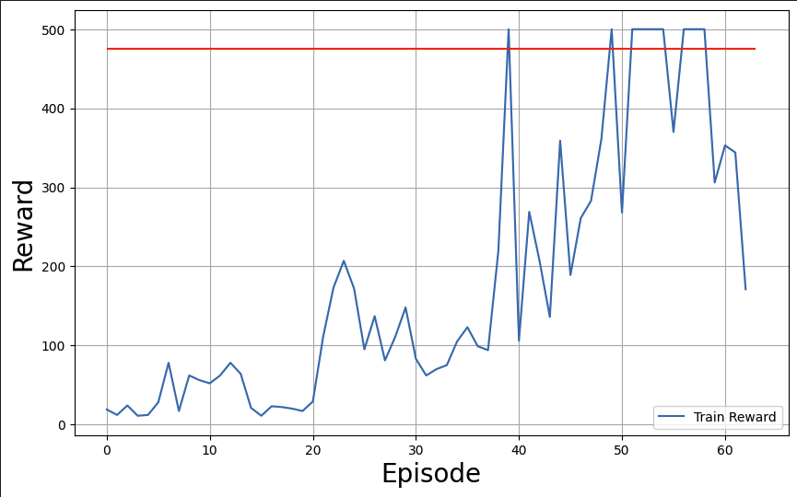
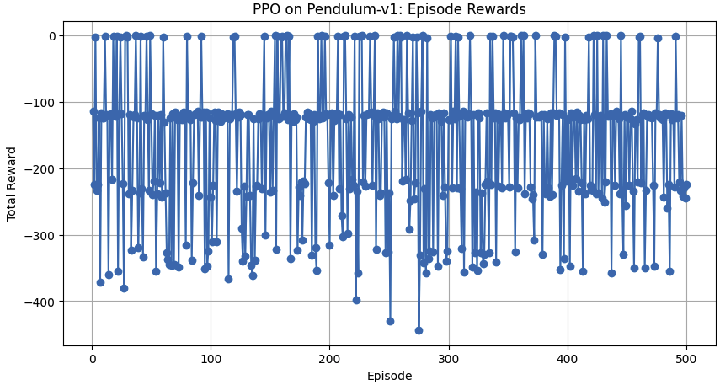
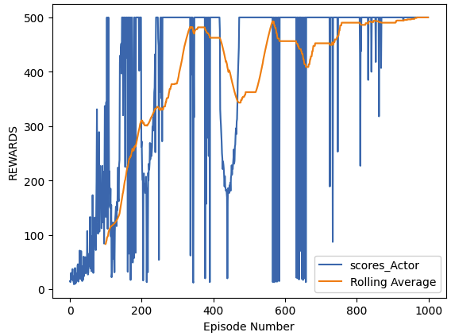
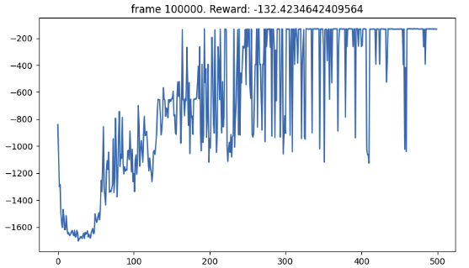
PPO Cartpole-v1
PPO Pendulum-v1
A2C Cartpole-v1
A2C Pendulum-v1

Slide 12

Thank You
We extend our deepest gratitude to our professors and mentors. Your invaluable guidance, unwavering support, and profound insights have been instrumental in our learning journey and the successful development of this project. Thank you for empowering us to achieve our goals.

